Slide 1
Modern Workflow Talk Outline
Welcome to The Modern Salesforce Development Workflow with Visual Studio Code
The Problem: cross platform development is hard
What is Visual Studio Code
Open Source: Electron (Atom Shell) serves as the foundation with the Roslyn Code Editor (Open Source) resting on top
Modern App: Fast, Lightweight, Cross-Platform, Built with JavaScript, and Hackable to the core (edit the editor with the editor)
Nice Features: Fantastic Git integration, Node.js debugging, Keyboard centric workflow, and Tasks
What is the Modern Workflow we are discussing
JavaScript SPAs built with Angular and Typescript, and NPM
Salesforce files built using VRO, Remote Actions w/ Apex Patterns, REST API, and connected Node.js Apps (Heroku)
How can we use VSCode in the Modern Salesforce workflow
Grammars and Snippets (Firstmate/Textmate grammars thanks to Joe Ferraro)
Tasks with Tasks.json controlling and passing variables to Gulp & Force CLI, Ant, or anything
Auto-Deploy SF files with Gulp watch task
Auto-Deploy SPA files with Webpack watch task
Future extensibility with Omnisharp with the goal of implementing Intellisense for Apex and VF

Slide 2
The Modern Salesforce Development Workflow with Visual Studio Code
Why you should use Visual Studio Code for your current and next Salesforce project
John Aaron Nelson
Senior Front End Developer
john.nelson@codescience.com
@JohnAaronNelson

Slide 3
Safe Harbor
Safe harbor statement under the Private Securities Litigation Reform Act of 1995:
This presentation may contain forward-looking statements that involve risks, uncertainties, and assumptions. If any such uncertainties materialize or if any of the assumptions proves incorrect, the results of salesforce.com, inc. could differ materially from the results expressed or implied by the forward-looking statements we make. All statements other than statements of historical fact could be deemed forward-looking, including any projections of product or service availability, subscriber growth, earnings, revenues, or other financial items and any statements regarding strategies or plans of management for future operations, statements of belief, any statements concerning new, planned, or upgraded services or technology developments and customer contracts or use of our services.
The risks and uncertainties referred to above include – but are not limited to – risks associated with developing and delivering new functionality for our service, new products and services, our new business model, our past operating losses, possible fluctuations in our operating results and rate of growth, interruptions or delays in our Web hosting, breach of our security measures, the outcome of any litigation, risks associated with completed and any possible mergers and acquisitions, the immature market in which we operate, our relatively limited operating history, our ability to expand, retain, and motivate our employees and manage our growth, new releases of our service and successful customer deployment, our limited history reselling non-salesforce.com products, and utilization and selling to larger enterprise customers. Further information on potential factors that could affect the financial results of salesforce.com, inc. is included in our annual report on Form 10-K for the most recent fiscal year and in our quarterly report on Form 10-Q for the most recent fiscal quarter. These documents and others containing important disclosures are available on the SEC Filings section of the Investor Information section of our Web site.
Any unreleased services or features referenced in this or other presentations, press releases or public statements are not currently available and may not be delivered on time or at all. Customers who purchase our services should make the purchase decisions based upon features that are currently available. Salesforce.com, inc. assumes no obligation and does not intend to update these forward-looking statements.

Slide 4
Welcome to The Modern Salesforce Development Workflow with Visual Studio Code
Salesforce 2015

Slide 5
John Nelson @JohnAaronNelson
Code Scientist

Slide 6
Dan Shahin @hijinx
Senior Developer Evangelist

Slide 7

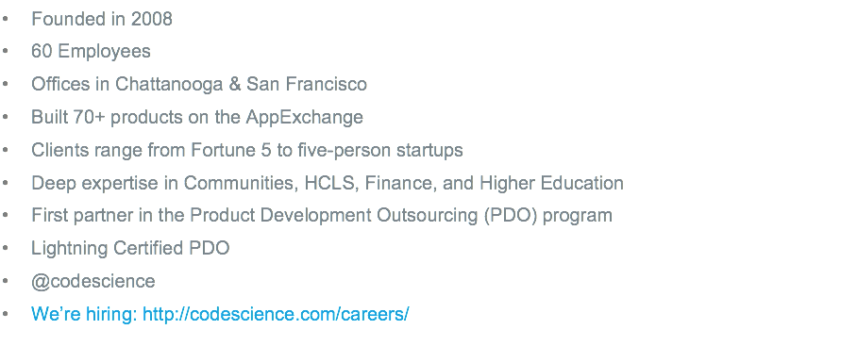

Slide 8
The Problem
Modern JavaScript development with Salesforce can be painful.
Notes:
So what’s the deal? Why are we here?
Douglas Crockford said “The people who should be the first to recognize the value of an innovation are often the last.”

Slide 9
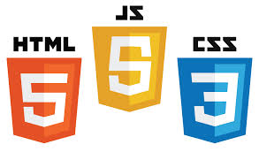







+
+
+
?
=

Slide 10
Introducing Visual Studio Code
Introduced April 30th 2015 at Microsoft //Build conference (currently at 0.7.0)

Slide 11
Visual Studio Code
Offers a new choice of tool that combines the simplicity of a code editor with what we need as developers for the code-edit-debug cycle

Slide 12
Built with open source tools
* mostly

Slide 13





OmniSharp
Roslyn
Monaco Editor *

Slide 14
The Sweet Spot
Visual Studio Code offers everything we need and nothing we don’t

Slide 15
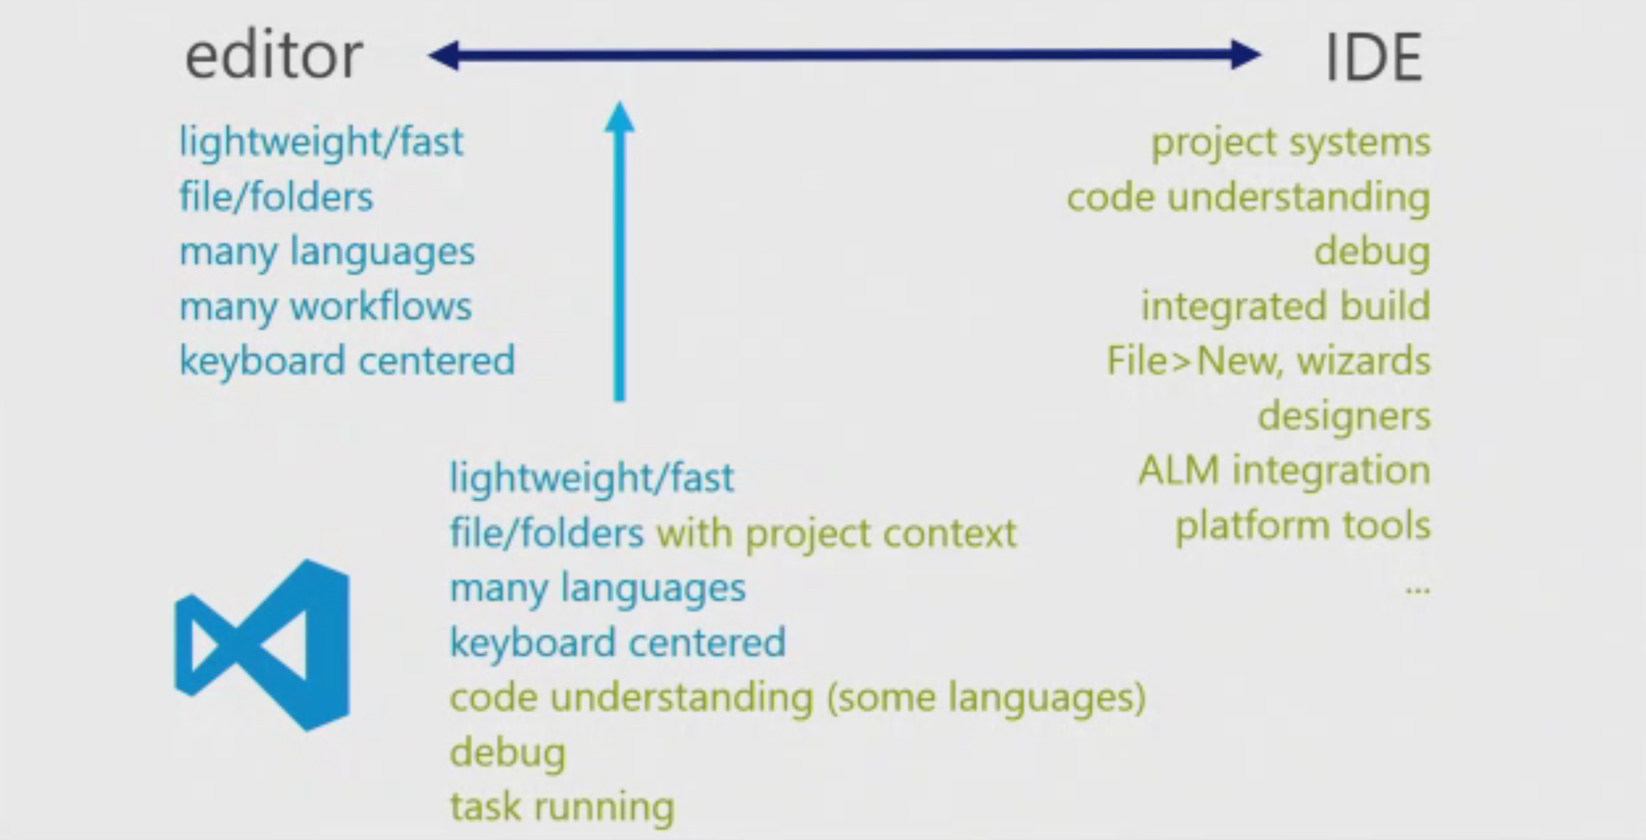

Slide 16
Using Visual Studio Code with Salesforce
Subtitle placeholder
Syntax Highlighting image goes here
Snippets image goes here

Slide 17
The modern Salesforce development workflow
Build JavaScript SPAs using Open Source tools

Slide 18






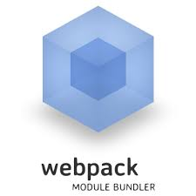
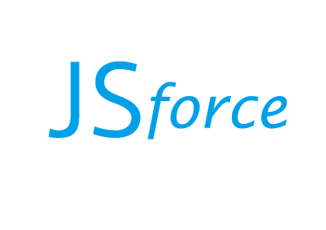
The Modern Workflow
heroku/force
Notes:
Build a Salesforce Javascript SPA

Slide 19
The Future is bright
Plugin support in Visual Studio Code is coming soon and will allow us to implement Intellisense for Apex and VF
Visual Studio Code UserVoice page shows how Visual Studio Code is a crowd-sourced application.

